Slide 1
Spring BOOT BaSIC

Slide 2

Spring Framework Basic
Spring Boot
Introduction
Spring Boot Annotations
Bootstrapping
REST with Spring Boot
Thymeleaf – connect Angular/UI
Application Properties & Profile
Spring Security
Build and Deploy Spring Boot Application
Notes:
Spring security: filter/ swarm

Slide 3
What is Spring framework
Spring Framework Basic
The framework provides a comprehensive programming and configuration model for modern Java-based enterprise applications
Providing rich features:
Core technologies: dependency injection, events, resources, i18n, validation, data binding, type conversion, SpEL, AOP.
Testing: mock objects, TestContext framework, Spring MVC Test, WebTestClient.
Data Access: transactions, DAO support, JDBC, ORM, Marshalling XML.
Spring MVC and Spring WebFlux web frameworks.
Integration: remoting, JMS, JCA, JMX, email, tasks, scheduling, cache.
Languages: Kotlin, Groovy, dynamic languages.

Slide 4
Spring Core
Spring Framework Basic
IOC Container
Bean
Dependency Injection

Slide 5
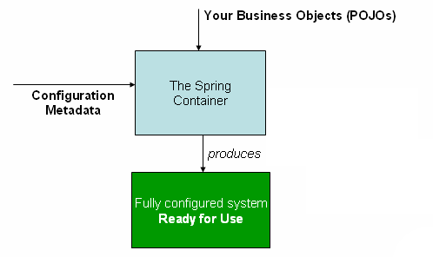
IOC Container
Spring Framework Basic
The container will create the objects, wire them together, configure them, and manage their complete life cycle from creation till destruction.
These objects are called Spring Beans.
The container gets its instructions on what objects to instantiate, configure, and assemble by reading the configuration metadata provided.
The configuration metadata can be represented
either by XML, Java annotations, or Java code.

Slide 6
IOC Container - Spring
Spring Framework Basic
Spring provides the following two distinct types of containers:
Spring BeanFactory Container
This is the simplest container providing the basic support for DI and is defined by the org.springframework.beans.factory.BeanFactory interface.
The BeanFactory and related interfaces, such as BeanFactoryAware, InitializingBean, DisposableBean, are still present in Spring for the purpose of backward compatibility with a large number of third-party frameworks that integrate with Spring.
Spring ApplicationContext Container
This container adds more enterprise-specific functionality such as the ability to resolve textual messages from a properties file and the ability to publish application events to interested event listeners.
This container is defined by the org.springframework.context.ApplicationContext interface.

Slide 7
Bean
Spring Framework Basic
The objects that form the backbone of your application and that are managed by the Spring IoC container are called beans.
Bean definition contains the information called configuration metadata, which is needed for the container to know the following:
How to create a bean
Bean's lifecycle details
Bean's dependencies
Three important methods to provide configuration metadata to the Spring Container:
XML based configuration file
Annotation-based configuration
Java-based configuration

Slide 8
Bean – Configuration Metadata Example
Spring Framework Basic
…
<!-- A bean definition with initialization method -->
<bean id = "..." class = "..." init-method = "...">
<!-- collaborators and configuration for this bean go here -->
</bean>
<!-- A bean definition with destruction method -->
<bean id = "..." class = "..." destroy-method = "...">
<!-- collaborators and configuration for this bean go here -->
</bean>
<!-- more bean definitions go here -->
</beans>
<?xml version = "1.0" encoding = "UTF-8"?>
<beans >
<!-- A simple bean definition -->
<bean id = "..." class = "...">
<!-- collaborators and configuration for this bean go here -->
</bean>
<!-- A bean definition with lazy init set on -->
<bean id = "..." class = "..." lazy-init = "true">
<!-- collaborators and configuration for this bean go here -->
</bean>
…

Slide 9
Bean Scope
Spring Framework Basic
Scope | Description
Singleton | This scopes the bean definition to a single instance per Spring IoC container (default).
Prototype | This scopes a single bean definition to have any number of object instances.
Request | This scopes a bean definition to an HTTP request. Only valid in the context of a web-aware Spring ApplicationContext.
Session | This scopes a bean definition to an HTTP session. Only valid in the context of a web-aware Spring ApplicationContext.
Global-session | This scopes a bean definition to a global HTTP session. Only valid in the context of a web-aware Spring ApplicationContext.

Slide 10
Bean Scope - Example
Spring Framework Basic
public class MainApp {
public static void main(String[] args) {
ApplicationContext context = new ClassPathXmlApplicationContext("Beans.xml");
HelloWorld objA = (HelloWorld) context.getBean("helloWorld");
objA.setMessage("I'm object A");
objA.getMessage();
HelloWorld objB = (HelloWorld) context.getBean("helloWorld");
objB.getMessage();
}
}
…
Your Message : I'm object A
Your Message : I'm object A
HelloWorld.java
public class HelloWorld {
private String message;
public void setMessage(String message){
this.message = message;
}
public void getMessage(){
System.out.println("Your Message : " + message);
}
}
Beans.xml
<bean id = "helloWorld" class = "com.bosch.HelloWorld" scope = "singleton">
</bean>

Slide 11
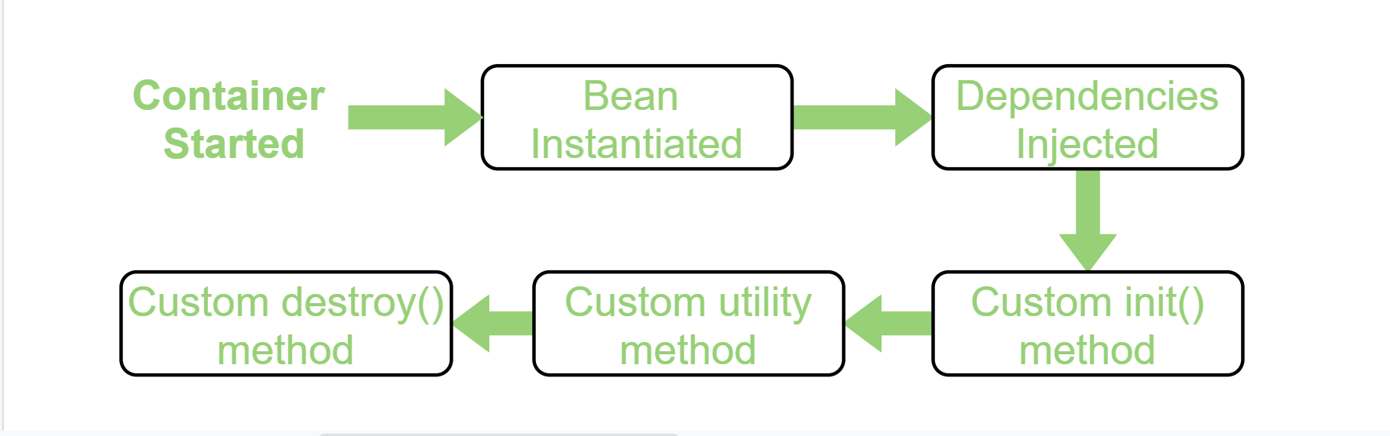
Bean Life Cycle
Spring Framework Basic
Bean life cycle is managed by the spring container.
When we run the program then, first of all, the spring container gets started.
After that, the container creates the instance of a bean as per the request, and then dependencies are injected.
And finally, the bean is destroyed when the spring container is closed.
Therefore, if we want to execute some code on the bean instantiation and just after closing the spring container, then we can write that code inside the custom init() method and the destroy() method.

Slide 12
Bean Life Cycle - Example
Spring Framework Basic
Beans.xml
<bean id = "helloWorld" class = "com.ex" init-method = "init"
destroy-method = "destroy">
<property name = "message" value = "Hello World!"/>
</bean>
Main
public class MainApp {
public static void main(String[] args) {
ApplicationContext context = new classPathXmlApplicationContext("Beans.xml");
HelloWorld obj = (HelloWorld) context.getBean("helloWorld");
obj.getMessage();
context.registerShutdownHook(); }
}
…
Bean is going through init.
Your Message : Hello World!
Bean will destroy now.
HelloWorld.java
public class HelloWorld {
private String message;
public void setMessage(String message){
this.message = message;
}
public void getMessage(){
System.out.println("Your Message : " + message);
}
public void init(){
System.out.println("Bean is going through init.");
}
public void destroy() {
System.out.println("Bean will destroy now.");
}
}

Slide 13
Dependency Injection
Spring Framework Basic
In a complex Java application, application classes should be as independent as possible:
Increase the possibility of reusable
Test them independently while unit testing
-> Dependency Injection helps in gluing these classes together and at the same time keeping them independent.
public class TextEditor {
private SpellChecker spellChecker;
public TextEditor() {
spellChecker = new SpellChecker();
}
}
public class TextEditor {
private SpellChecker spellChecker;
public TextEditor(SpellChecker spellChecker) {
this.spellChecker = spellChecker;
}
}
Dependency Injection Type:
Constructor-based dependency injection
Setter-based dependency injection
@Autowired @Inject - Spring

Slide 14
Quiz
Notes:
What is the ordering of console log when executing following code:
public class TextEditor {
private SpellChecker spellChecker;
// a setter method to inject the dependency.
public void setSpellChecker(SpellChecker spellChecker) {
System.out.println("Inside setSpellChecker." );
this.spellChecker = spellChecker;
}
// a getter method to return spellChecker
public SpellChecker getSpellChecker() {
return spellChecker;
}
public void spellCheck() {
spellChecker.checkSpelling();
}
}
public class SpellChecker {
public SpellChecker(){
System.out.println("Inside SpellChecker constructor." );
}
public void checkSpelling(){
System.out.println("Inside checkSpelling." );
}
}
public class MainApp {
public static void main(String[] args) {
ApplicationContext context = new ClassPathXmlApplicationContext("Beans.xml");
TextEditor te = (TextEditor) context.getBean("textEditor");
te.spellCheck();
}
}
<?xml version = "1.0" encoding = "UTF-8"?>
<beans xmlns = "http://www.springframework.org/schema/beans"
xmlns:xsi = "http://www.w3.org/2001/XMLSchema-instance"
xsi:schemaLocation = "http://www.springframework.org/schema/beans
http://www.springframework.org/schema/beans/spring-beans-3.0.xsd">
<!-- Definition for textEditor bean using inner bean -->
<bean id = "textEditor" class = "com.tutorialspoint.TextEditor">
<property name = "spellChecker">
<bean id = "spellChecker" class = "com.tutorialspoint.SpellChecker"/>
</property>
</bean>
</beans>

Slide 15

Introduction
Spring Boot
A solution for creating stand-alone, production-grade Spring based Applications that you can "just run".
A suite of pre-configured frameworks and technologies that is used to remove boilerplate configuration
Goals:
To avoid complex XML configuration in Spring
To develop a production ready Spring applications in an easier way
To reduce the development time and run the application independently
Offer an easier way of getting started with the application
Advantages:
Easy to understand and develop spring applications
Increases productivity
Reduces the development time

Slide 16
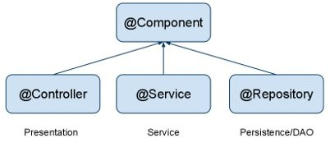
Spring Boot Annotations
Spring Boot
@SpringBootApplication: We use this annotation to mark the main class of a Spring Boot application
@EnableAutoConfiguration: Spring Boot automatically configures your application based on the dependencies you have added to the project
@ComponentScan: Spring Boot automatically scans all the components included in the project
*Note: @SpringBootApplication encapsulates @Configuration, @EnableAutoConfiguration, and @ComponentScan annotations with their default attributes.

Slide 17
Bootstrapping
Spring Boot
Handling dependency management is a difficult task for big projects. Spring Boot resolves this problem by providing a set of dependencies for developers convenience
Spring Boot Starters:
Spring Boot Starter Actuator dependency is used to monitor and manage your application
Spring Boot Starter Security dependency is used for Spring Security
Spring Boot Starter web dependency is used to write a Rest Endpoints
Spring Boot Starter Thyme Leaf dependency is used to create a web application
Spring Boot Starter Test dependency is used for writing Test cases.

Slide 18
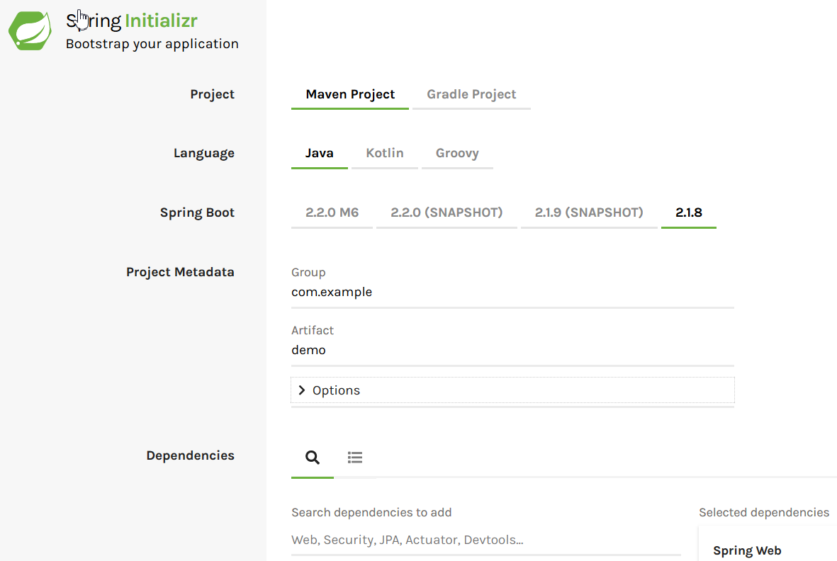
Bootstrap first application
Spring Boot
https://start.spring.io/

Slide 19
Bootstrap first application

Slide 20
RESTful with Spring Boot
Spring Boot
@RestController annotation is used to define the RESTful web services:
@RestController
public class ProductServiceController {
}
@RequestMapping annotation is used to define the Request URI to access the REST Endpoints. We can define Request method to consume and produce object. The default request method is GET:
@RequestMapping(value = "/products")
public ResponseEntity<Object> getProducts() { }
@RequestBody annotation is used to define the request body content type:
public ResponseEntity<Object> createProduct(@RequestBody Product product) {
}

Slide 21
RESTful with Spring Boot
Spring Boot
@PathVariable annotation is used to define the custom or dynamic request URI. The Path variable in request URI is defined as curly braces {}:
public ResponseEntity<Object> updateProduct(@PathVariable("id") String id) {
}
@RequestParam annotation is used to read the request parameters from the Request URL. By default, it is a required parameter:
public ResponseEntity<Object> getProduct(
@RequestParam(value = "name", required = false, defaultValue = "honey") String name) {
}
Method: GET, POST, PUT, DELETE

Slide 22
first resTFUL application

Slide 23
Thymeleaf with Spring Boot
Spring Boot
Thymeleaf is a Java-based library used to create a web application. It provides a good support for serving a XHTML/HTML5 in web applications.
Create an simple Thymeleaf app with Spring Boot:
Add Thymeleaf dependency
Add Controller
Add Web Resources (View)

Slide 24
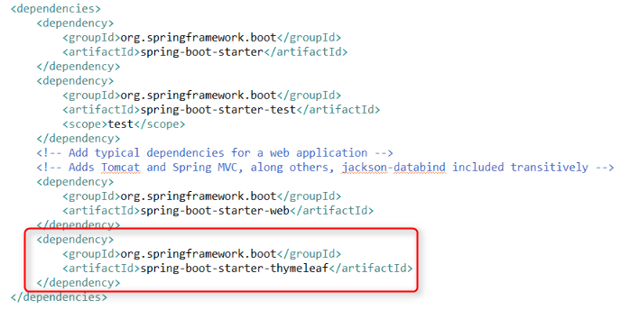
Add Thymleaf depedency
Thymeleaf with Spring Boot

Slide 25
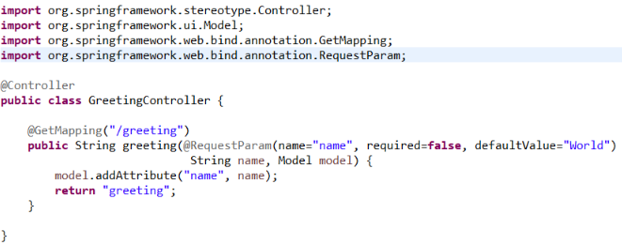
Add Controller
Thymeleaf with Spring Boot

Slide 26
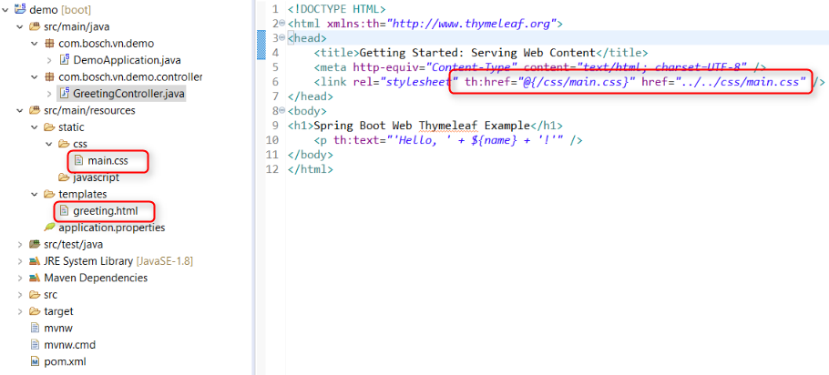
Add web resources
Thymeleaf with Spring Boot

Slide 27
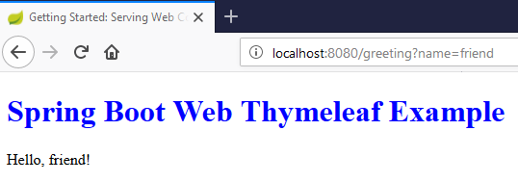
Thymeleaf app with Spring Boot
Thymeleaf with Spring Boot

Slide 28
Create a thymleaf app with spring boot

Slide 29

Application Properties
Spring Boot
Application Properties support us to work in different environments.
Command Line Properties
Spring Boot converts the command line properties into Spring Boot Environment properties.
Ex: Spring Boot uses the 8080 port number to start the Tomcat by default. We can change the default port by using command line properties
Properties File
Properties files are used to keep properties in a single file to run the application in a different environment. In Spring Boot, properties are kept in the application.properties file under the classpath.
Ex: server.port = 9090
spring.application.name = demoservice

Slide 30
Application Properties
Spring Boot
YAML File
Spring Boot supports YAML based properties configurations to run the application
spring:
application:
name: demoservice
server:
port: 9090
Use of @Value Annotation
The @Value annotation is used to read the environment or application property value in Java code
Ex: @Value("${spring.application.name}")
Add default value to avoid exception: @Value("${spring.application.name:demoservice}")

Slide 31
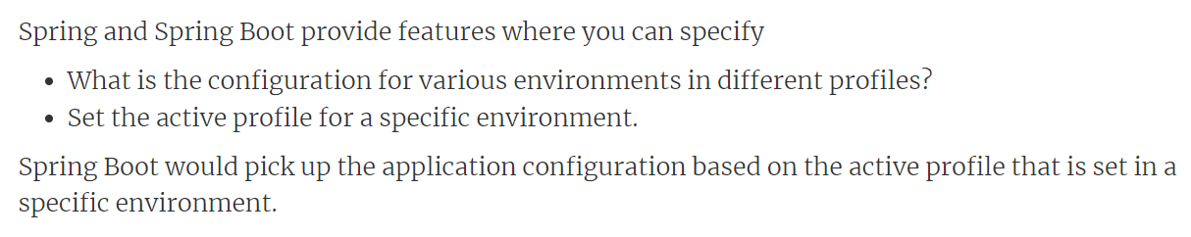
What is Spring profile
Spring Boot
Profiles help to have different application configuration for different environments

Slide 32
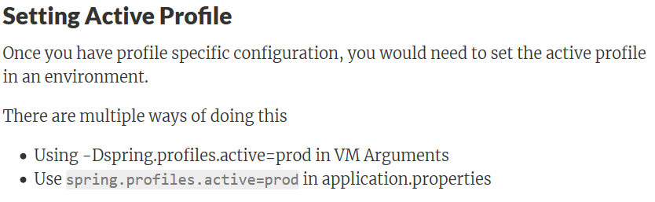
Set active profile
Spring Boot

Slide 33
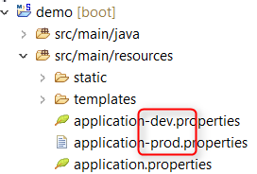



Profile resource messages
Spring Boot

Slide 34
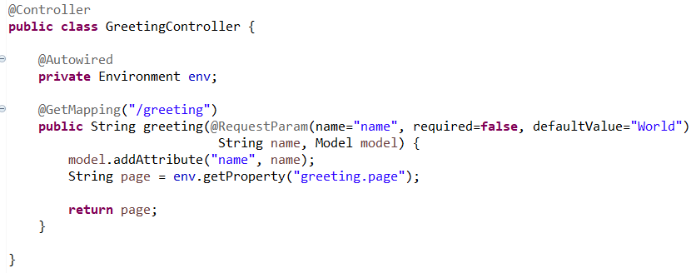
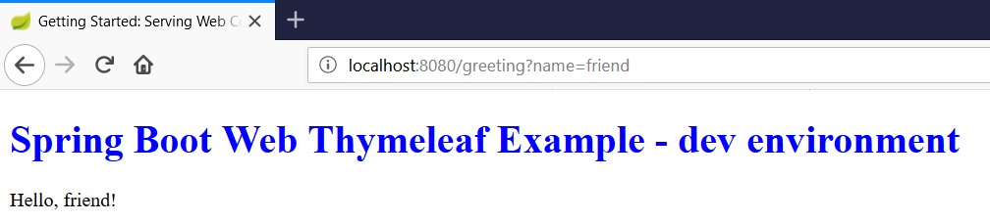
How profile message work
Spring Boot

Slide 35
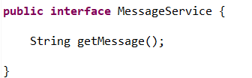
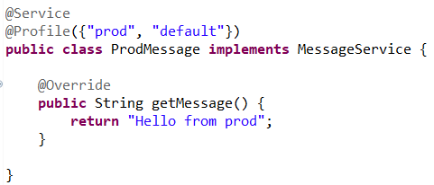
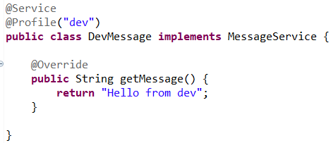
Profile services
Spring Boot
Profile with annotation @Profile
Create a message service with 2 implementations: DevMessage & ProdMessage

Slide 36
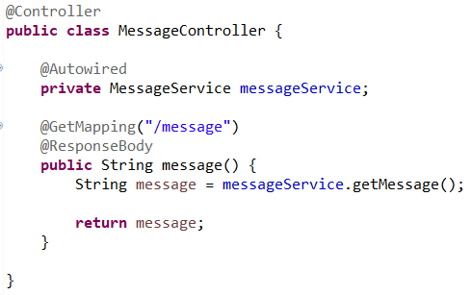
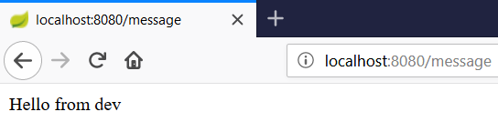
How profiled services work
Spring Boot
The result ----->

Slide 37
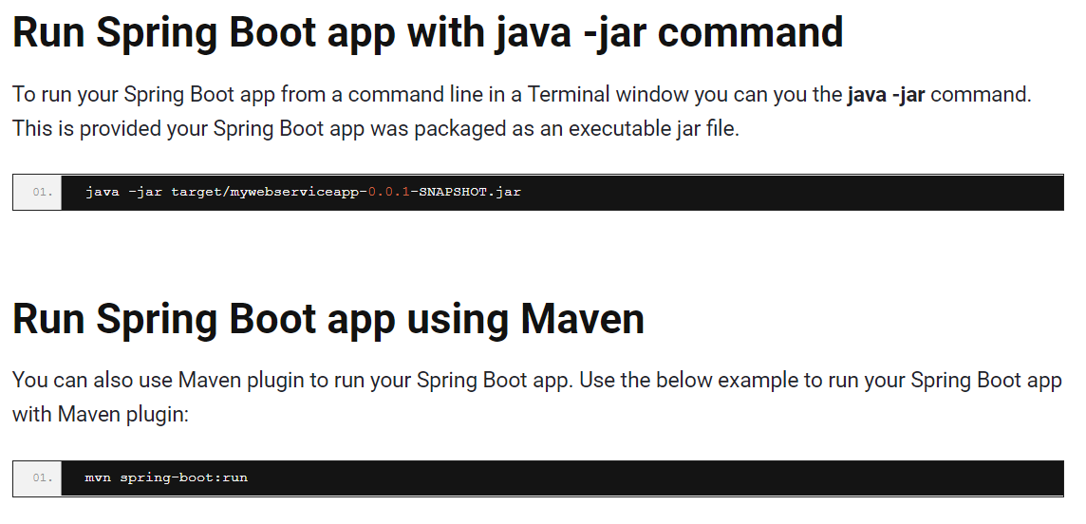
Run Spring Boot
Spring Boot

Slide 38
using application properties to connect db

Slide 39

Terminology Definition
Spring Security
Authentication refers to the process of verifying the identity of a user, based on provided credentials. A common example is entering a username and a password when you log in to a website. You can think of it as an answer to the question Who are you?.
Authorization refers to the process of determining if a user has proper permission to perform a particular action or read particular data, assuming that the user is successfully authenticated. You can think of it as an answer to the question Can a user do/read this?.
Principle refers to the currently authenticated user.
Granted authority refers to the permission of the authenticated user.
Role refers to a group of permissions of the authenticated user.

Slide 40
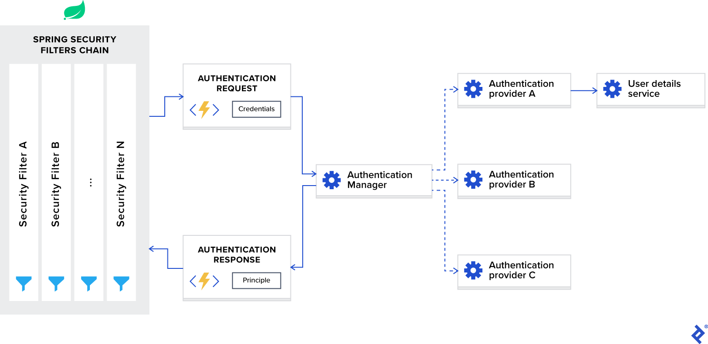
Architecture Overview
Spring Security
Notes:
Spring Security Filters Chain
When you add the Spring Security framework to your application, it automatically registers a filters chain that intercepts all incoming requests. This chain consists of various filters, and each of them handles a particular use case.
For example:
Check if the requested URL is publicly accessible, based on configuration.
In case of session-based authentication, check if the user is already authenticated in the current session.
Check if the user is authorized to perform the requested action, and so on.
AuthenticationManager
You can think of AuthenticationManager as a coordinator where you can register multiple providers, and based on the request type, it will deliver an authentication request to the correct provider.
AuthenticationProvider
AuthenticationProvider processes specific types of authentication. Its interface exposes only two functions:
authenticate performs authentication with the request.
supports checks if this provider supports the indicated authentication type.
One important implementation of the interface that we are using in our sample project is DaoAuthenticationProvider, which retrieves user details from a UserDetailsService.
UserDetailsService
UserDetailsService is described as a core interface that loads user-specific data in the Spring documentation.
In most use cases, authentication providers extract user identity information based on credentials from a database and then perform validation. Because this use case is so common, Spring developers decided to extract it as a separate interface, which exposes the single function:
loadUserByUsername accepts username as a parameter and returns the user identity object.

Slide 41
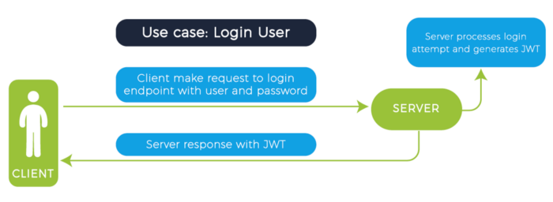

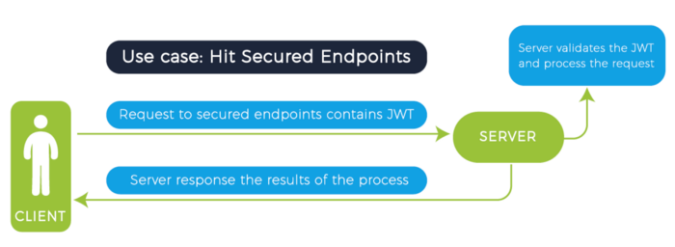

Authentication Using JWT
Spring Security

Slide 42
Build Up authentication jwt feature with spring security

Slide 43
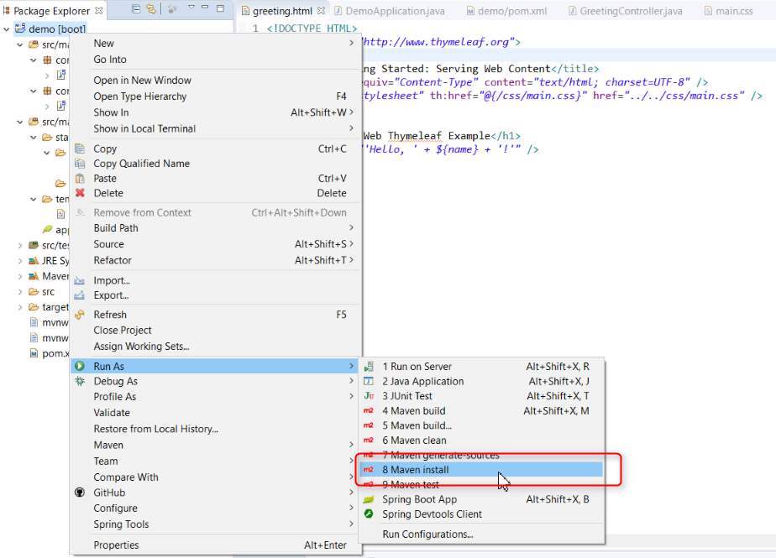
Build Spring Boot app
Build and deploy Spring Boot

Slide 44
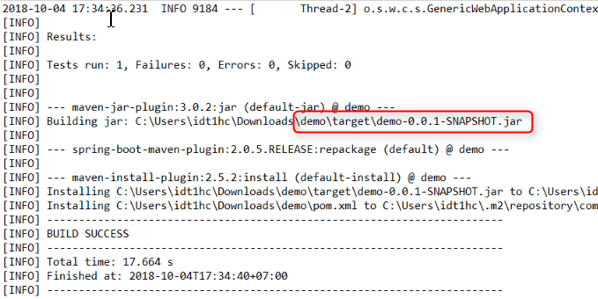
Build Spring Boot App
Build and deploy Spring Boot

Slide 45
But I need a *.war file to deploy that application to my tomcat server as traditional way. Is it possible ?

Slide 46
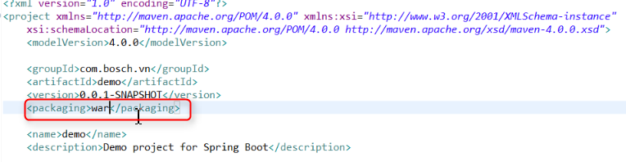
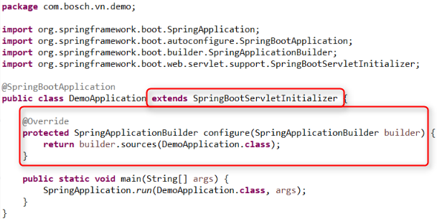

Build Spring Boot App
Build and deploy Spring Boot

Slide 47
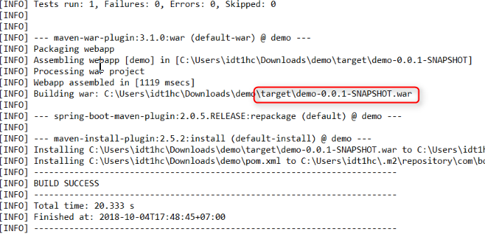
Build Spring Boot App
Build and deploy Spring Boot

Slide 48

Q&A

Slide 49
References
https://docs.spring.io/
https://www.tutorialspoint.com/spring/index.htm
https://www.tutorialspoint.com/spring_boot/index.htm
https://www.baeldung.com/spring-boot
https://www.toptal.com/spring/spring-security-tutorial
https://www.javainuse.com/spring/boot-jwt
https://www.baeldung.com/rest-with-spring-series
https://www.baeldung.com/spring-response-status
https://www.baeldung.com/exception-handling-for-rest-with-spring

